Slide 1


Tradalysis
In today’s dynamic financial markets, investors are inundated with vast amounts of data, making it increasingly difficult to make informed investment decisions. Understanding a stock's true potential requires a deep dive into both its fundamental financial health and its behavior in the market, reflected through various technical indicators and chart patterns. However, the sheer complexity and volume of this data often lead to suboptimal decision-making, especially when insights into industry trends and company-specific factors are overlooked.

Slide 2
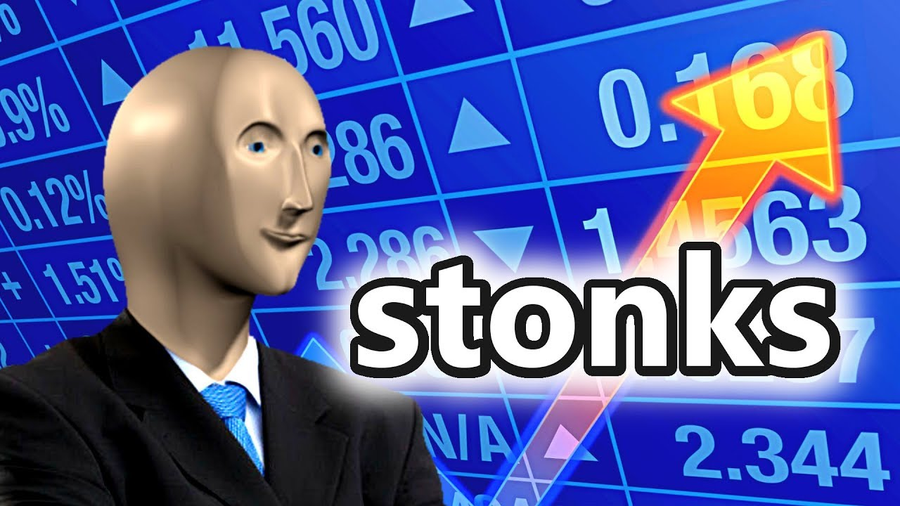
Problem Statement
Investors face significant challenges in making informed stock market decisions due to the overwhelming volume of financial data, the complexity of analyzing both fundamental and technical indicators, and the difficulty in interpreting chart patterns and market trends.
Additionally, there is a lack of accessible tools that provide comprehensive insights into a company's industry, market position, and future trends. These challenges make it difficult for investors to accurately assess stock potential and industry dynamics, leading to suboptimal investment decisions.
,

Slide 3


Solution
To address these challenges, we will develop a software application that integrates fundamental and technical analysis, including chart patterns and market trends, to provide investors with clear, actionable insights. The application will offer comprehensive company and industry analysis, leveraging data from financial indicators and predictive algorithms used by successful investors. By simplifying the complex process of stock evaluation, the tool will empower investors to make informed, data-driven decisions with greater confidence.

Slide 4
Technical approach
Android application dev with NSE API calls
Backend APIs written in python , predictors using a combination of ml models and open APIs present , with JWT authentication and postgres and MongoDB database
Hosting on AWS EC2 , compute instances
Using docker and kubernetes to run multiple nodes of backend together

Slide 5
Technical approach
Company News:
Source: News APIs like NewsAPI, Google News, or a custom web scraper to fetch relevant financial news.
Approach: Implement NLP (Natural Language Processing) to extract sentiment from the news articles. Use libraries like NLTK, spaCy, or Transformers (from Hugging Face) for sentiment analysis.
Research Papers and Reports (for Product Analysis):
Source: want to scrape research papers from sources like Google Scholar, ArXiv, or even industry reports.
Approach: Use a combination of NLP and data extraction methods to identify key insights related to the company's industry.

Slide 6
Technical approach (cont.)
Stock Price Prediction:
Approach: You’ll need machine learning models for this. Classic models include ARIMA, LSTM (Long Short-Term Memory), and Sentimental analysis with NLP LSTM models are particularly good for time-series prediction as they can capture long-term dependencies.
Feature Engineering: Use technical indicators, historical prices, and external factors like sentiment or economic indicators as features.
Libraries: Use TensorFlow or PyTorch for building LSTM models, and Prophet for trend forecasting.
Product Growth Analysis:
Approach: Use sentiment analysis on research papers and industry reports to predict trends. You might also look at public datasets on market size, technology adoption, and product growth metrics.
Sentiment Analysis: Classify whether the news/research papers suggest positive or negative trends for the company's products. This could be done using sentiment classification models.
Risk Analysis:
Use statistical models to assess the volatility of the stock. Calculate Value at Risk (VaR) or Conditional Value at Risk (CVaR) using historical data to provide insights into risk.

Slide 7
Target audience
From novice to expert
Beginner to highly skilled

Slide 8
Feasibility
Technical Feasibility:
Data Collection: Accessible via APIs (Alpha Vantage, Yahoo Finance) and web scraping for news and research.
Machine Learning: Predictive models (LSTM, ARIMA) are feasible but require careful tuning for accuracy.
NLP for Sentiment: Proven libraries (spaCy, Hugging Face) make sentiment analysis achievable.
Operational Feasibility:
Cloud Infrastructure: Easily deployable on AWS, Google Cloud, or Azure.
Challenges: Managing API limits, ensuring real-time data processing, and cost optimization
Legal Feasibility:
Legal feasibility:
Compliance with data privacy laws and financial regulations is necessary for successful deployment.

Slide 9
Scalability
Data Volume: Scalable with time-series databases and cloud-based storage solutions.
Real-Time Processing: Use distributed systems (Kafka, AWS Kinesis) to manage growing traffic.
Machine Learning: Scalable model training with cloud-based GPU/TPU instances.
Modular Architecture: Microservices enable independent scaling of data processing, prediction, and UI services.
Challenges: Maintaining low-latency, handling increased user load, and optimizing cloud costs.

Slide 10
Impact
User Empowerment and Financial Literacy
Enables users, especially beginners, to learn and practice trading with dummy tokens in a risk-free environment.
Enhances users' understanding of stock market dynamics and boosts confidence in making investment decisions.
Market Growth and Accessibility
Increases retail investor participation by lowering barriers to entry for stock trading.
Makes investment opportunities more accessible to a broader audience, fostering inclusive financial growth.

Slide 11
Impact (Contd..)
Technological Innovation
Utilizes advanced algorithms and AI-driven predictions to provide personalized stock insights.
Processes real-time data efficiently, offering users up-to-date and actionable information.
Social and Economic Contribution
Promotes financial inclusion by democratizing access to stock trading for diverse user groups.
Contributes to the growth of the Indian stock market, supporting economic development.

